Slide 1
Human resources update
For Human Resources Department
By Jessica Baxter
Turing College Module 2 Sprint 2 Project
Notes:
Hello and welcome to the human resources update for the human resources department. Today we will be discussing the ins and outs of the individuals on the Adventure Works team and the insights we can gain from their contribution to the company.

Slide 2
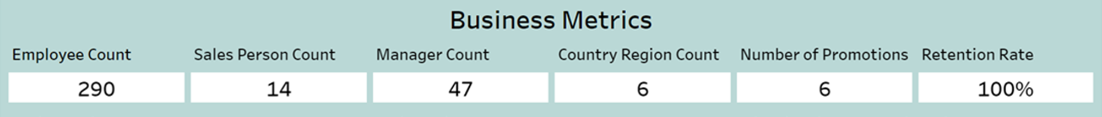
Adventure Works Company Overview
Notes:
Firstly, I would like to start with business metrics to see the overall health of the company. As you can see there are a total of 290 employees, 14 of those employees being salespeople and 47 employees in a managerial role. These employees work across a total of 6 different countries around the world. While there have only been 6 promotions over the past 8 years the retention rate is 100%.

Slide 3
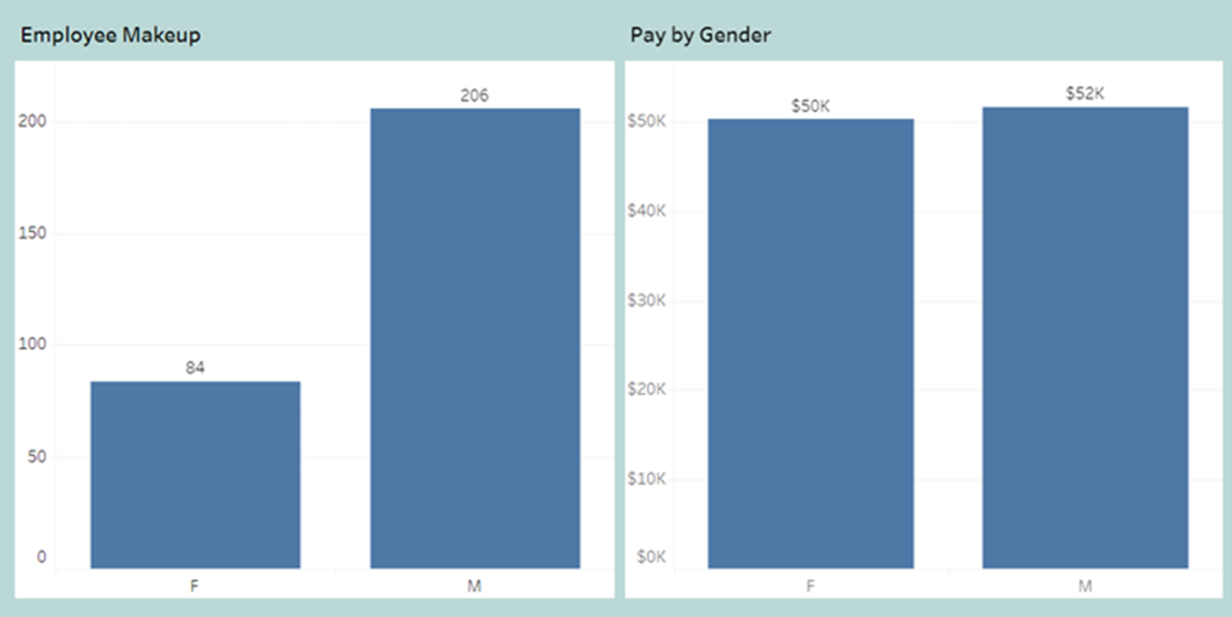
Makeup and pay of Employees
Notes:
The total makeup of employees is very uneven. There is a 2.5x more men than women working at Adventure Works.
However, despite the massive difference in how many more men than women are employed at Adventure Works, they are being paid nearly identically.

Slide 4
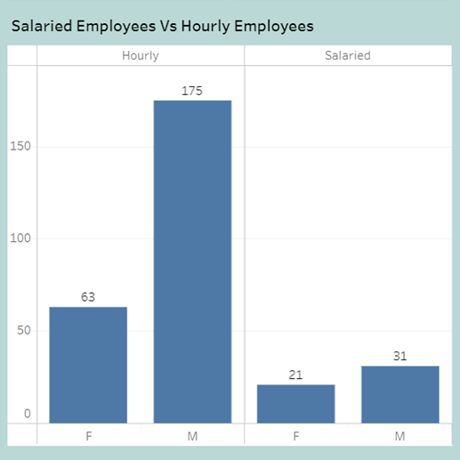
Hourly vs salaried employees
Notes:
Here we can see the distribution of hourly and salaried employees. There are about 4x more hourly workers than salaried workers. What department do you think makes up the bulk of these hourly employees?

Slide 5
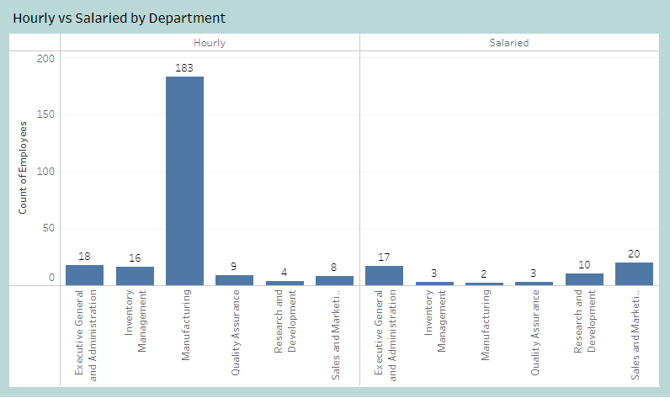
Hourly vs salaried employees
Notes:
Breaking this down further, we can see that the manufacturing department makes up the majority of hourly employees.

Slide 6
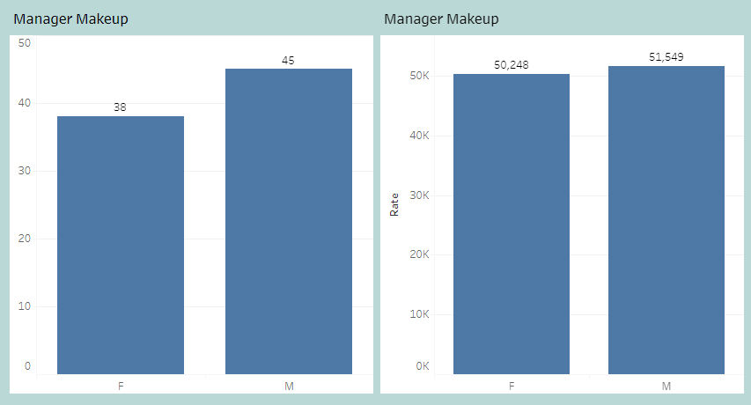
Makeup of Managers
Notes:
The makeup of managers at Adventure Works is only slightly uneven, but their pay is evenly distributed.

Slide 7
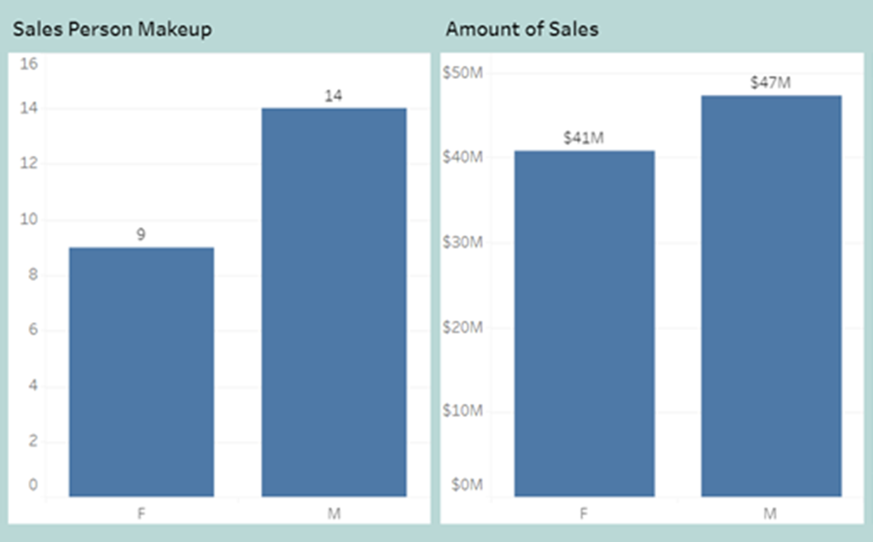
Makeup and sales of Salespeople
Notes:
I also looked into the makeup of salespeople. Again, we see a bit of a disparity between the number of women and men in this role, but it not as vast a difference like between the total number of men and women who work at the company.
Once again, when looking at the amount being brought in by sales, women and men bring in very similar numbers through sales.
But what is happening here?

Slide 8
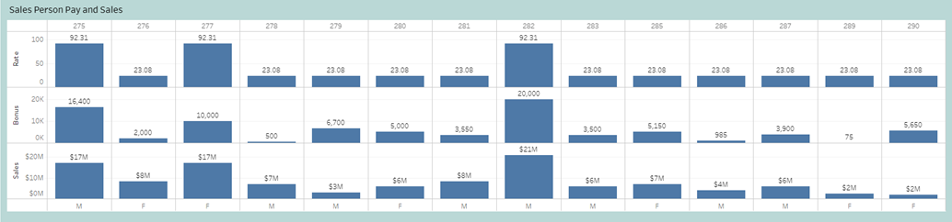
Salesperson pay and sales
Notes:
Breaking the salespeople up individually to see who are making the most sales we see something really interesting

Slide 9
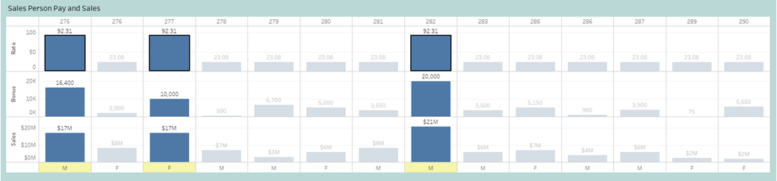
Salesperson pay and sales
Notes:
There are 3 individuals who are making the most in sales and bringing in the most in pay and bonuses.

Slide 10
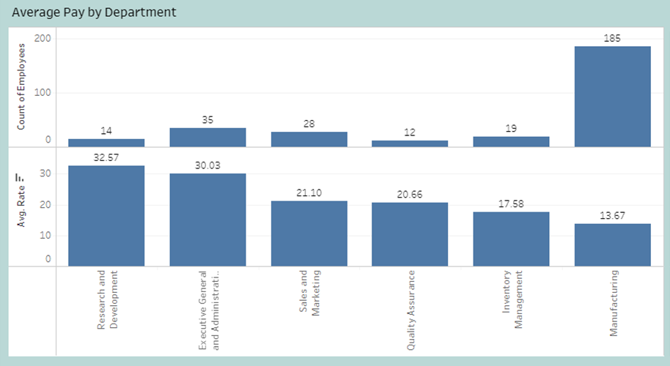
Average pay by department
Notes:
Looking at things a little bit differently we can see there seems to be, roughly, an inverse correlation to each other. The department with the highest average wages has one of the fewest people, while the department with the most people has the lowest average wages.

Slide 11
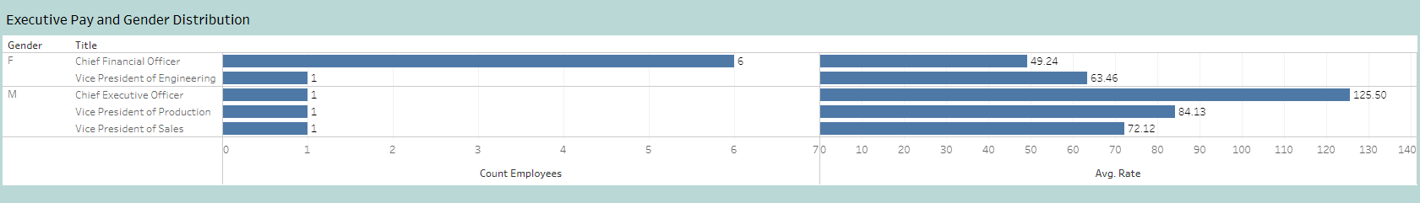
Executive Pay and Gender Distribution
Notes:
Looking a little more closely at pay by department, I looked at those in high up executive roles and their pay distribution. These individuals, of course, are some of the top earners at the company. I find it interesting that all 6 CFOs are women. I personally love it, girl power and all that, I just found it interesting.

Slide 12
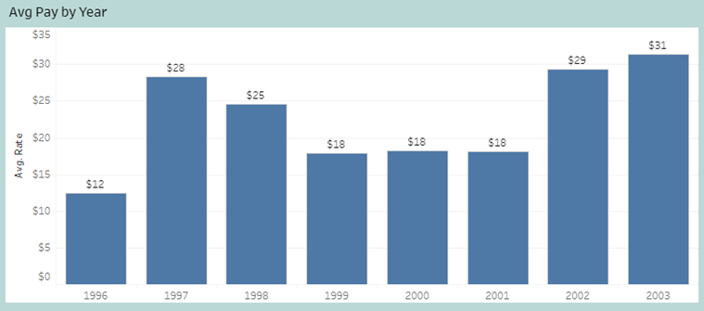
Average pay by Year
Notes:
One of the other things that I have found interesting was looking at average pay over the years. Interestingly there is a spike in 1997, the year after the business got started. Then wages went down until 1999 and stayed stagnant there until 2002 when wages picked up again. I’m not sure what could have caused this shift, I’m sure there are a number of possibilities.

Slide 13
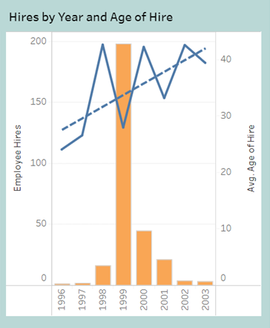
Hires and age of hire over time
Notes:
Lastly, I’d like to share the number of hires and the average ages of hires over time. In the orange bars, we can see a huge spike in employment in 1999 with a decline in hires ever since. We can also see the age at which employees are being hired, that solid blue line, and the average age of hire is going up, the dotted blue line.

Slide 14
What can we do?
Notes:
So, to wrap up, what can we do with this information? How do we keep growing? Let me give some thoughts.

Slide 15
What can we do?
Send a survey out to employees
Utilize top sales earners
Competitive Pay
Try to hire a mix of ages
Notes:
When thinking about the first slide here, I know it was a while ago, remember when I said that the retention rate is 100% and the number of promotions over the past 8 years has only been 6?
If that doesn’t make sense to you, don’t worry I don’t really understand it either
There are a couple of theories, one being that Adventure Works doesn’t keep records of current employees. While I think that would be more work than just putting an end date to their employment, it is quite possible.
Another theory is that there is actually a 100% retention rate, how cool would that be, no employees leave for any reason. However, it is improbable.
Since there is no way for me to know which is actually the case, I am going to go with what the data tell me, that there is actually a 100% retention rate.
To get into why this is may happening I would recommend sending out a survey to all employees to understand why employees are staying at Adventure Works.

Slide 16
What can we do?
Send a survey out to employees
Utilize top sales earners
Competitive Pay
Try to hire a mix of ages
Notes:
When looking to the sales department, we could look to those 3 top sale earners
To capitalize on those employees, we could have those employees run a workshop to help others on the sales team to hopefully boost sales all around. This in turn would in turn improve business for Adventure Works as a whole.

Slide 17
What can we do?
Send a survey out to employees
Utilize top sales earners
Competitive Pay
Try to hire a mix of ages
Notes:
A big reason employees stay at their workplaces is they are being offered competitive wages for the work they do. I might recommend a study to compare the pay of Adventure Works employees receive and the pay of their competitors.
The average salary in the manufacturing industry is about $43,864 a year, or $21.09 an hour. While the average pay at Adventure Works ranged from $18-$31 depending on the year. This sits about average nation wide, though it might be useful to compare pay to local companies to see how they compare. Pay can depend greatly depending on the location the average wage in, the average manufacturing employee in California, for example, makes around $40 an hour while a manufacturing employee in, say, Michigan will make around $20 an hour on average.

Slide 18
What can we do?
Send a survey out to employees
Utilize top sales earners
Competitive Pay
Try to hire a mix of ages
Notes:
My last recommendation would be to hire a mix of ages. The steady increase in hiring age over the years could lead to the loss of new ideas in younger individuals that could lead to new innovations in the way we do business at Adventure Works. There are perks to hiring older individuals, they have more experience, more industry knowledge and would need less training to get up and running in a new role. On the other hand, in hiring older workers each year, this shortens the amount of time they would be at the company before retiring, which would lead us back to hiring again.

Slide 19
Thank you for your time Questions?
Notes:
I would love to thank you for your time. Does anyone have any questions?

